Slide 1

PCMP Onboarding
Northeast Health Partners - RAE 2
June 11, 2025

Slide 2
Introductions

Slide 3

AGENDA
ACC Phase III and NHP Overview
Member Rights and Services
EPSDT
Access to Care Standards
Maintain PCMP Information
Care Coordination Services
Quality Improvement
Practice Transformation
Member Attribution
PMPM Payment Process
Resources

Slide 4
PCMP Manual is available on
NHP Website www.nhprae2.org)
Notes:
Most of the information we will briefly review today is on the PCMP Manual available on the Provider Page of the NHP Website. We encourage that you download the PCMP Manual and review it.
The website is currently under construction and will go live starting July 1, 2025. However, we have created a temporary page for Providers that has all of this information for your use.
Note that the PCMP Manual is subject to update to reflect state, federal or NHP policy changes.
Should you have any questions, please email Network Management.

Slide 5
ACC Phase III Overview

Slide 6


Accountable Care Collaborative (ACC) Phase III
The Department of Health Care Policy & Financing has selected NHP to serve as the RAE for Region 2, effective July 1, 2025

Slide 7
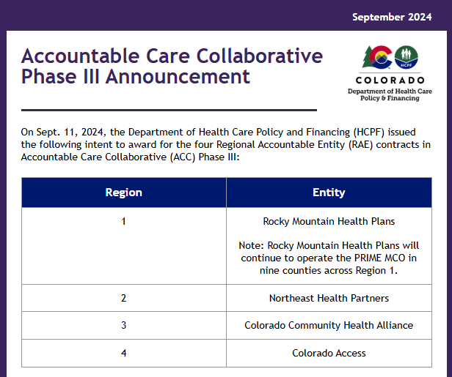
ACC Phase III Regional Entities

Slide 8
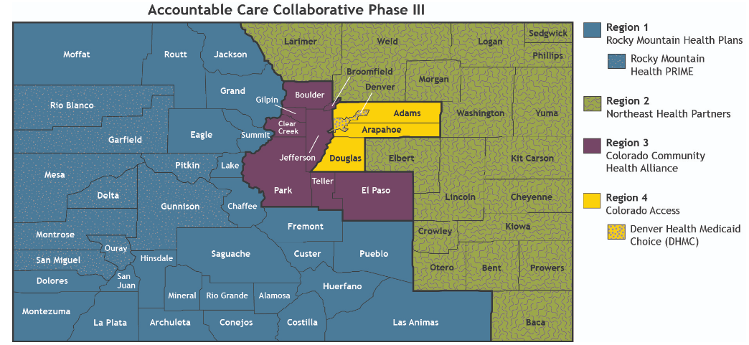
ACC Phase III RAE Map

Slide 9
What Is a Regional Accountable Entity?
Every Health First Colorado member has a primary care provider and is assigned to a Regional Accountable Entity (RAE).
RAEs are Managed Care Entities who have a contract with the State of Colorado to be responsible for coordinating Health First Colorado members' care ensuring members are connected with primary and behavioral health care and developing regional strategies to serve their communities.
RAEs provide care coordination for members and build behavioral and primary care provider networks to help connect members with care. RAEs pay providers for behavioral health services through a payment called capitation.

Slide 10
NHP Overview

Slide 11

Who Is NHP?
Northeast Health Partners (NHP) is a non-profit regional organization.
We manage physical and behavioral health services for individuals who live within our 18 counties.

Slide 12
Mission & Vision
Mission
It is our mission to serve the members in our communities and provide a comprehensive range of physical and behavioral health services with commitment to compassionate service to meet the needs of our members.
Vision
To become the state’s preeminent Medicaid health plan by connecting local communities and resources together to meet member and provider needs.

Slide 13
Values
Unwavering Leadership: We strive to take the lead in advocating for our members, our providers, and our community groups to streamline process and eliminate unnecessary burdens to ensure seamless access to services.
Customer Service: We are committed to maintaining high-satisfaction for the service we provide across members, providers, and community-based organizations.
Achievement: We believe in continuous improvement and constant refinement to achieve results and offer high-quality care to Coloradans.

Slide 14
Values
Responsiveness: We strive to be nimble and efficient in our operations and services.
Commitment: As a local organization focused on healthcare, we are committed to the community to ensure high-value services are available and accessible.
Transparency: We believe in clarity and openness to our activities for both our providers network and the public.

Slide 15
Member Rights and Services

Slide 16

Providers must be aware of and uphold Health First Colorado members’ benefits, services and rights.

Slide 17
Physical Health Benefits
• Acute (short-term) home health therapies & services
• Allergy testing and injections
• Ambulance services for an emergency
• Transportation to your appointments and services
• Audiology
• Durable medical equipment (DME)
• Emergency room visits
• Family planning services
• Habilitative services and devices
• Rehabilitation services and devices
• Home health care
• Hospice care
• Inpatient medical and surgical care
• Lab and radiology
• Long-term home health therapies and services • Outpatient hospital services
• Outpatient surgery
• PCP visits
• Pediatric services, including oral and vision care
• Prescription drugs
• Preventive and wellness services, such as screenings
• Private duty nursing
• Skilled nursing services
• Specialist visits
• Telehealth
• Urgent care
• Vision services
• Vaccinations (shots)
• Women’s health services

Slide 18
Transportation
Non-Emergent Medical Transportation (NEMT) is a Health First Colorado benefit for members who do not have transportation to medical appointments. Members can be referred to NHP or their Care Coordination to help schedule transportation.
Please see the following resource to help members identify their local NEMT resource: https://www.healthfirstcolorado.com/wp-content/uploads/2021/07/NEMT- CountyMap.pdf

Slide 19
Colorado Crisis Services
Colorado Crisis Services provides free, confidential and immediate support
from trained professionals and peer specialists, available 24/7/365. Colorado
residents can also seek services in-person at walk-in centers, regardless of ability
to pay. Members can seek help for mental health, substance use, or emotional
concerns—for themselves or others. When in doubt, start here.
Call: 844-493-TALK (8255) or Text: "TALK" to 38255
For more information: https://coloradocrisisservices.org/

Slide 20
Nurse Advice Line
Nurse Advice Line provides Health First Colorado (Colorado’s
Medicaid program) members free medical information and advice,
in both English and Spanish, 24 hours a day, every day of the year.
Call 800-283-3221
For more information:
https://www.healthfirstcolorado.com/benefits-services/nurseadvice
line

Slide 21
Learn about Member Rights & Grievances
Member Rights:
Review Member Rights on NHP website
Post Member Rights in prominent place
Member Complaints:
Post information on how a member can file a complaint
Members can file a complaint through member call line or emailing the member services email
For assistance reach out to Member Services at 800-541-6870 or email at nhpmembersupport@nhpllc.org

Slide 22
Early and Periodic Screening, Diagnosis and Treatment (EPSDT) Services

Slide 23
For resources related to EPSDT, please go to the Health Care, Policy and Financing website at https://hcpf.colorado.gov/early- and-periodic-screening-diagnostic-and-treatment-epsdt.
Visit HCPF’s EPSDT website at: https://hcpf.colorado.gov/early-and-periodic-screening-diagnostic-and- treatment-epsdt.
EPSDT is a comprehensive and preventative health care service for children and youth ages 20 and under including adults who are pregnant, who are enrolled in Health First Colorado.
EPSDT is key to ensuring that children and youth receive appropriate preventive, dental, mental health, developmental and specialty services.
Any medically necessary health care service is covered under EPSDT.
A service may be covered even if it is not a Health First Colorado benefit.
No arbitrary limitations on services are allowed.
All qualified Health First Colorado providers can offer EPSDT services.

Slide 24
Why EPSDT Matters
EPSDT is a federally mandated benefit ensuring children and youth under 21 enrolled in Medicaid receive preventive care, early diagnosis, and necessary treatment.
As a provider, you are essential to ensuring these services are delivered consistently and effectively.

Slide 25
PCMPs Role in EPSDT
Engage
Engage Members in Routine Well-Child Visits: Schedule Bright Futures-aligned screenings and promote preventive care.
Screening
Screening and Documentation: Perform and document screenings per Bright Futures Guidelines.
Identify
Referral and Follow-Up: Identify concerns, make referrals, and track follow-through.
Outreach
Outreach to Non-Utilizers: Support efforts to re-engage families in care.
Participate in
Participate in Value-Based Programs: Meet EPSDT benchmarks to earn incentive payments.

Slide 26
NHP Support for You
Regular training and guidance on EPSDT requirements.
Bright Futures resources and communication tools.
Performance dashboards and data sharing.
Care coordination and provider liaison assistance.

Slide 27
Access to Care Standards

Slide 28

Appointment Standards
Primary Care Services are provided to Members on a timely basis, as follows:
Urgent Care – within 24 hours after the initial identification of need.
Outpatient Follow-up Appointments – within seven days after discharge from a hospitalization.
Non-urgent, Symptomatic Care Visit – within seven days after the request.
Well Care Visit – within one month after the request; unless an appointment is required sooner to ensure the provision of screenings in accordance with Department’s accepted Bright Futures schedule.

Slide 29
Access to Care Standards
Providers are expected to adhere to Access to Care standards for Health First Colorado members. Providers should, at a minimum, comply with the following:
Providers shall not place members on a waiting list for initial routine service requests. If a member is not able to be scheduled, they should be referred back to the RAE to identify a new provider.
Ensure the same availability to all members regardless of payer.
Support minimum hours of operation to include service coverage from 8:00 a.m.–5:00 p.m. Mountain Time, Monday through Friday.
Offer extended hours, outside the hours from 8:00 a.m.–5:00 p.m., on evenings and weekends, and/or offer alternatives for emergency room visits for after-hour urgent care to include access to clinical staff, not just an answering service or referral service staff.

Slide 30
Practice Hours
Hours of Operation: Providers who serve Health First Colorado members shall offer hours of operation that are no less than the hours of operation offered to commercial enrollees. Minimum hours of provider operation shall include covered service coverage from 8 a.m. to 5 p.m. Monday through Friday and emergency coverage 24 hours a day, seven (7) days a week.
Extended Hours of Operation: Extended Hours of Operation and covered service coverage must be provided for at least two (2) days per week at clinic treatment sites, which should include a combination of additional morning, evening, or weekend hours, to accommodate members who are unable to attend appointments during standard business hours.
Evening and/or Weekend Support Services: Members and families should have access to clinical staff over evenings and weekends, not just an answering service or referral service staff.

Slide 31
Maintain PCMP Practice Information

Slide 32
PCMP Practice Sites are required to notify NHP of any changes to the practice within 30 days.

Slide 33
Changes that Require NHP Notification
Organization
Practice Site
Practitioner
Owner/Parent Company
Tax ID Number
Mailing Address
Contact Person(s)
Address
NPI
Medicaid ID
ADA Compliance
Phone Number
Panel Configuration Changes
Changes in Hours of Operation
Contact Person(s)
Practitioner Added
Practitioner Removed
Practitioner is on Leave
Practitioner NPI or Medicaid ID
Changes in Population served (age, gender, specialty)

Slide 34
PCMP Panel Configuration
PCMPs may limit or adjust their panel size at any time.
Once a panel limit is reached, no further attributions will be made.
PCMPs may turn auto-assignment (geographically based attributions) on or off at any time by contacting their RAE Network Representative.
PCMPs can configure their RAE Member attribution panel in the following ways:
Auto-Assignment Panel Limit Population Parameters
Notes:
All Tier 3 practice sites must accept geographic-proximity auto attributions, also known as auto- assignment, for all months in which they intend to operate as a Tier 3. If geographic auto-attribution exceeds a panel limit set by the practice, the practice must adjust it in the Department’s PCMP system appropriately to receive additional member assignments — no later than the first day of the next calendar quarter. The practice should consult in advance with NHP if it expects a panel limit to affect auto-attribution and tier status.

Slide 35
Complete PCMP Information Form (PIF)
PCMP Information Form has 3 tabs.
    GENERAL - Make sure to complete the tab and include the best contacts.
    PRACTICE SITES - all Medicaid Enrolled within the Region 2 counties.
    PRACTITIONERS - medical care providers within the Practice Sites.
You can find the template on NHP Website here:
Submit the updated PIF to Contracting@nhpllc.org
You can use the same email should you have questions on the form.
Notes:
PCMP contracted with the RAE assigned to your county will allow the PCMP practices to be the Medical Home for the members attributed. PCMPs will receive a Per Member Per Month payment for those members attributed.
Other services that the PCMP will receive is:
-Care coordination support, specifically in transitions of care from hospitalizations and support for complex members.
-Practice Transformation support to enhance your practice as a medical home
-Potential to earn incentives based on performance of the individual practices based on performance measures.
The PMPM amounts and performance measures are being finalized based on the final budget with the State. We are hoping to have completed soon.
In the meantime, work with me to get you ready when the contract is released.

Slide 36
Care Coordination Referral Process

Slide 37
Best Practices
PERSON CENTERED
COLLABORATION
EFFICIENCY
TRAINING
Adapting outreach strategies and support service to the needs of the individuals- culture, religion, disabilities, health, literacy & financial.
Defining roles and responsibilities, flexibility, training, communication channels, sharing information, data sharing, action plans – who, what, when, where, and being aligned.
Data sharing agreements, standardized meetings, policy and procedures.
Comprehensive training programs regarding waivers, behavioral health, State plan benefits, creative solutions, tools & technology.

Slide 38
Services for Children & Youth
New RAE requirements to improve screening of EPSDT eligible populations and support with referrals, including:
  Training and outreach
  Promote early identification of children across places of service
  Processes to track positive screens and referrals

Slide 39
Care Coordination
NHP supports the full continuum of care coordination, including:
A 3-tier model for person-centered care
Care coordination policy guide for children and adults
Partnerships with community organizations and agencies
Requirements for members with complex needs and transitions of care
Targeted outreach for preventive care
Proactive outreach for members with diagnosed conditions
Complex case management and collaboration with multi-provider teams

Slide 40
Care Coordination
Transitions of Care
Phase III emphasizes transitions of care (e.g., inpatient hospital, emergency department, mental health facilities, crisis systems, Creative/Complex Solutions).
NHP has developed workflows and will collaborate with practices to quickly schedule members, ensuring timely compliance with transition of care requirements.
Performance standards:
  ➢ 30-day follow-up for physical health inpatient stay (target: national average)
  ➢ 7-day follow-up for behavioral health inpatient discharge (target: national average)

Slide 41
NHP Care Coordination: Engaging Members
CONNECTING
LINKING
ASSISTING
SUPPORTING
Connecting members with services and providers
Linking members to resources such as transportation, food assistance, housing and other social services
Assisting members with understanding their medical conditions
Supporting members in managing physical and behavioral benefits
Facilitating the appropriate delivery and coordination of physical, behavioral health and social services & providing members with care management/care coordination

Slide 42
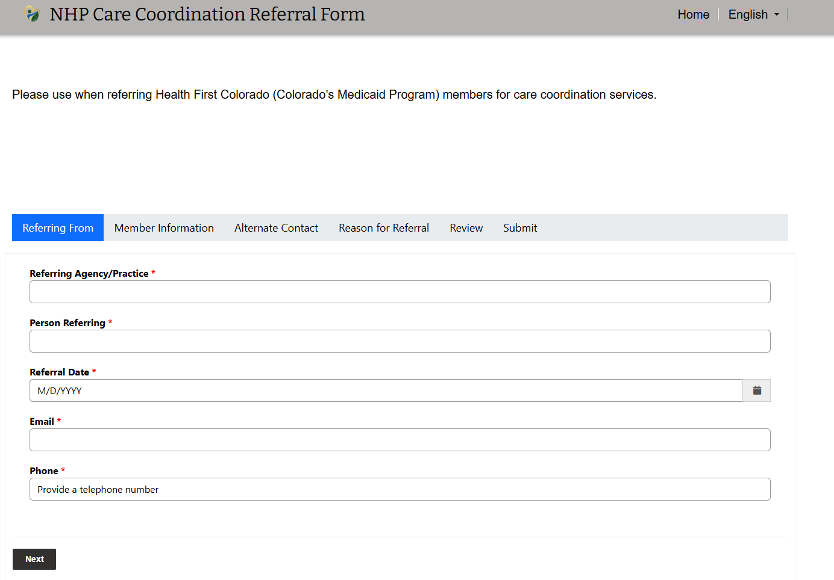
Care Coordination Referrals
Visit to the online form https://site-emju3.powerappsportals.com/
To do:
Give information that will assist the Care Coordinator in making successful contact and engagement.
Consider warm hand-off and invite to a visit.
Provide your expectations of what you want to happen.
Ask for updates and give feed-back .

Slide 43
Quality Improvement:
Performance Measures

Slide 44
Overview of Incentive Programs
3 Programs
Key Performance Indicators
Behavioral Health Incentive Program
Investment Pool
Important Notice:
$4.50 pulled from Admin PMPM from HCPF
Distribution across KPI/PP is unknown
Performance Pool/Investment Pool is unknown

Slide 45
Behavioral Health Incentive Program (BHIP)
Initiation & Engagement of Substance Use Disorder Treatment
  2 rates: Initiation & Engagement
Follow-Up After Hospitalization for Mental Illness
  2 rates: 7 Days & 30 Days
Follow-Up After ED Visit for SUD
  2 rates: 7 Days & 30 Days
Screening for Social Drivers of Health (SDOH)
  Food Insecurity
  Housing Instability
  Transportation Needs
  Utility Difficulties
  Interpersonal Safety

Slide 46
Key Performance Indicators: KPIs
6 Measures – some choice in what you want to be measured on
Primarily HEDIS/CMS Core Measures
Shifting to calendar year
Clinic-based goals and incentives
100% pass-through (no overhead). Impacts:
  Community Investment Grants
  Safety Net Payments

Slide 47
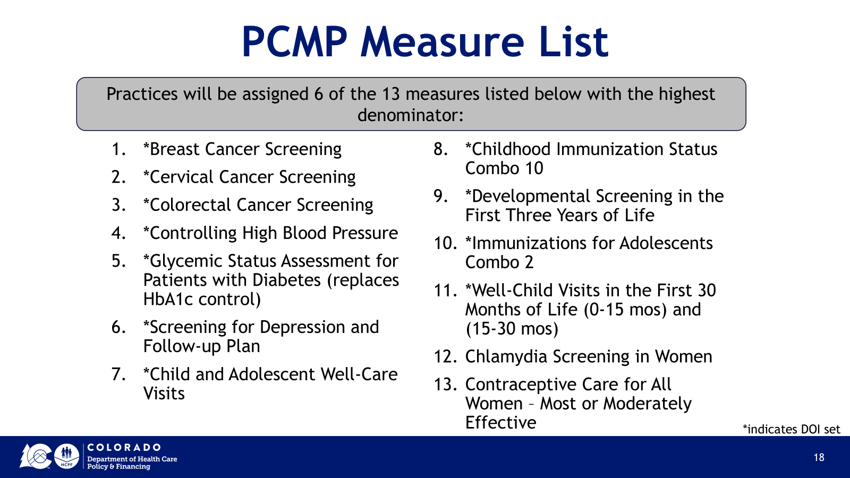
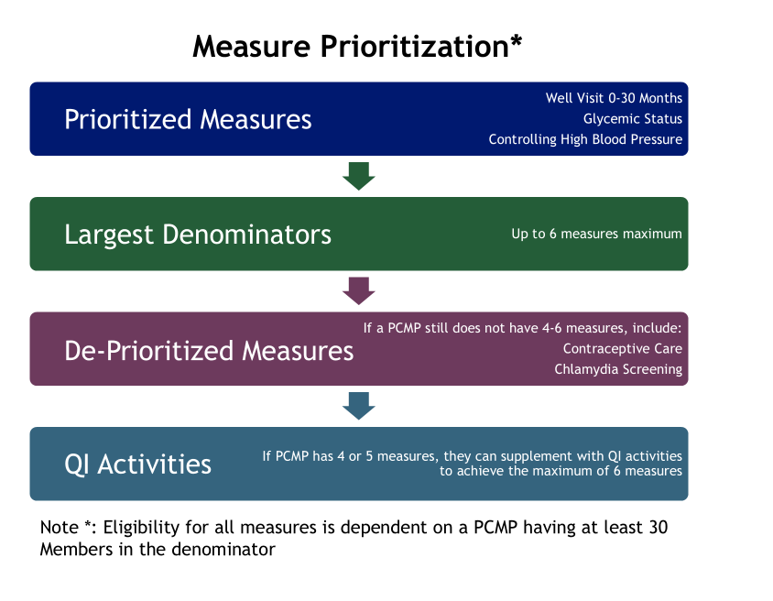
Key Performance Indicators: KPIs
Performance measures are not the same in Phase III
13 measures to choose from; some are prioritized
4-6 measures max
Most are aligned to APM Measures
Most are Aligned to CMS Core Measures
Practices are measured individually, not regionally

Slide 48
Key Performance Indicators: KPIs
Year 1
Year 2+
Incentive
Payments
No KPIs
KPIs Begin
Because the state is moving to a calendar year, the first payments may not be received until 18 months (or more) after the start of the new contract.
All Practices will engage in Practice Transformation
Performance measurement will be PI activities around improving baseline performance on future KPIs
Practices are broken into ether a Practice Transformation Track or a Performance Measures Track – depending on membership size
Practice Transformation Track will continue PI activities
Performance Track will work on KPIs similar to Phase II
Time to close the calendar year – starting in January of 2026
Plus time to calculate measures

Slide 49
Practice Transformation

Slide 50
What is Practice Transformation?
An overarching strategy encompassing activities that are focused on improving care delivery at PCMP Practice Sites. These activities include:
Supporting practices to refine workflows & improve processes
Developing projects to improve performance measure rates
Integrating behavioral & physical health care
Incorporating community health workers into the delivery system
Implementing Value-Based Payment models to achieve Department quality and cost savings targets.

Slide 51
Practice Transformation Coaches
Every PCMP Practice Site will be assigned an PT Coach.
PT Coaches engage with PCMPs and tailor support based on the National Committee for Quality Assurance (NCQA) Patient Centered Medical Home (PCMH) framework to address their unique needs based on patient population, geography, and practice goals.
To connect with your PT Coach call 888-599-4716 or email at NHPproviders@nhpllc.org
Notes:
PT Coaches collaborate with clinic team members to optimize workflows across the practice.

Slide 52
Member Attribution

Slide 53
Member Attribution Process for ACC Phase 3
Process | RAE Fast Facts
Mandatory Enrollment | Enrollment is mandatory. No opt-out. All Health First Colorado Members must enroll.
Enrollment Effective Date | Enrollment begins upon Member’s Health First Colorado eligibility determination.
Member Enrollment Region | Member enrollment in the RAE is based on the physical location of the Member’s attributed PCMP site, or the Member’s residence if there is no prior claim or patient choice history.
Member Attribution | RAE Members are immediately attributed to RAE upon being determined eligible for Health First Colorado benefits. RAE Members are attributed to PCMP only when there is prior claim or patient choice history.

Slide 54
Member Attribution Process for ACC Phase 3
Process | RAE Fast Facts
Member Re-Attribution | The Department will run a re-attribution process to attribute RAE Members/PCMPs based on claims during the most recent 18 months. This process occurs monthly for members ages 0 to 1 and unattributed members. This process occurs quarterly for all members. If the Member’s new attributed PCMP is in a different region, the Member’s RAE enrollment will change to the PCMP’s region. Members will receive a letter from Health First Colorado Enrollment informing them of the change with the PCMP and/or RAE information.

Slide 55
Payment Process

Slide 56
PMPM Maximum Payment Structure
 | Tier 1 | Tier 2 | Tier 3 | Tier 3+
PMPM Max (up to) | $2.00 | $4.50 | $7.00 | $10.00
Practice Assessment (7%) | $0.14 (7% of $2.00) | $0.32 (7% of $4.50) | $0.49 (7% of $7.00) | $0.70 (7% of $10.00)
CC and Acuity (70%) | $1.40 (70% of $2.00) | $3.15 (70% of $4.50) | $4.90 (70% of $7.00) | $7.00 (70% of $10.00)
Integrated BH (7%) | $0.14 (7% of $2.00) | $0.32 (7% of $4.50) | $0.49 (7% of $7.00) | $0.70 (7% of $10.00)
Special Programs (16%) | $0.32 (16% of $2.00) | $0.72 (16% of $4.50) | $1.12 (16% of $7.00) | $1.60 (16% of $10.00)

Slide 57
Payment Timeframes and Method
NHP pays a monthly PMPM to PCMPs for RAE Members based upon the PCMP Practice Site’s participating tier.
Providers receive PMPM payments within 30 days of the end of the month for which payment is being made.
PMPM Payments start in the first full month in which the Provider is enrolled with the Department as a PCMP, contracted with NHP, and the Provider has attributed Members.
Providers may set up direct deposit for PMPM payment by completing form available on NHP Website.

Slide 58
Resources

Slide 59
Resources
PCMP Manual
NHP Website
Updates & Newsletters
Where to sign up for updates and communications
Training Opportunities
A comprehensive guide to policies, procedures, referrals, covered services, and contact info.
All resources and most up to date information, forms, tools and resources for both members and providers.
Webinars, onboarding sessions, and required trainings.

Slide 60
Provider Trainings
NHP will be hosting trainings throughout the year. Stay tuned to it on NHP Website.
  nhprae2.org
Violet – free online training for NHP providers
  Use this link: https://www.joinviolet.com/partner/northeast-health-partners

Slide 61
Provider Quarterly Newsletter
Upcoming to Stay Informed!

Slide 62
Contact Information
Network Management
Care Coordination
Member Services and Community
Contractual Questions
Attribution Questions
Provider Orientation and Training
Panel Configuration questions
Eligibility Questions
Practice Transformation Coach
Call: 888-599-4716
Email: NHPproviders@nhpllc.org
To request care coordination assistance:
Call 888-502-4190
Email: nhpccreferrals@nhpllc.org
Care Coordination Referral Form: Provider Page of the NHP Website (www.nhprae2.org).
*New NHP website will go live 7/1/25
Members with complaints and behavioral health appeals
Release of Information Forms
Educate members on advisory councils
Member Services Call Center
Finding a provider or specialist
Issue member handbook or provider directory
Call: 800-541-6870
Email: nhpmembersupport@nhpllc.org

Slide 63
Open Forum

Slide 64
Congratulations!

