Slide 1
Northeast Health Partners
RAE 2
February 26, 2025

Slide 2
Agenda
Introductions
NHP Overview
ACC Phase III
Next Steps
Contact NHP
Questions/Discussion

Slide 3
Meet the NHP Team

Slide 4
NHP Team members
Kari Snelson, CEO
Dr. Brian Robertson, COO
Jen Hale-Coulson, Chief of Clinical Operations (COCO)
Tom Grimmer, CFO
Wayne Watkins, CIO
Raina Ali, Community Relations Manager
Jennefer Rolf, Project Manager
Chantel Hawkins, Quality Manager
Alee LaCalamito, Pop Health Manager
Natasha Lawless, Contract Manager
Laura Cornell, Administrative Manager
Diamila Konate, Data Analyst
Joanna Martinson, Regional Care Coordination Administrator
Alma Mejorado, Provider Network Consultant

Slide 5
NHP Overview

Slide 6
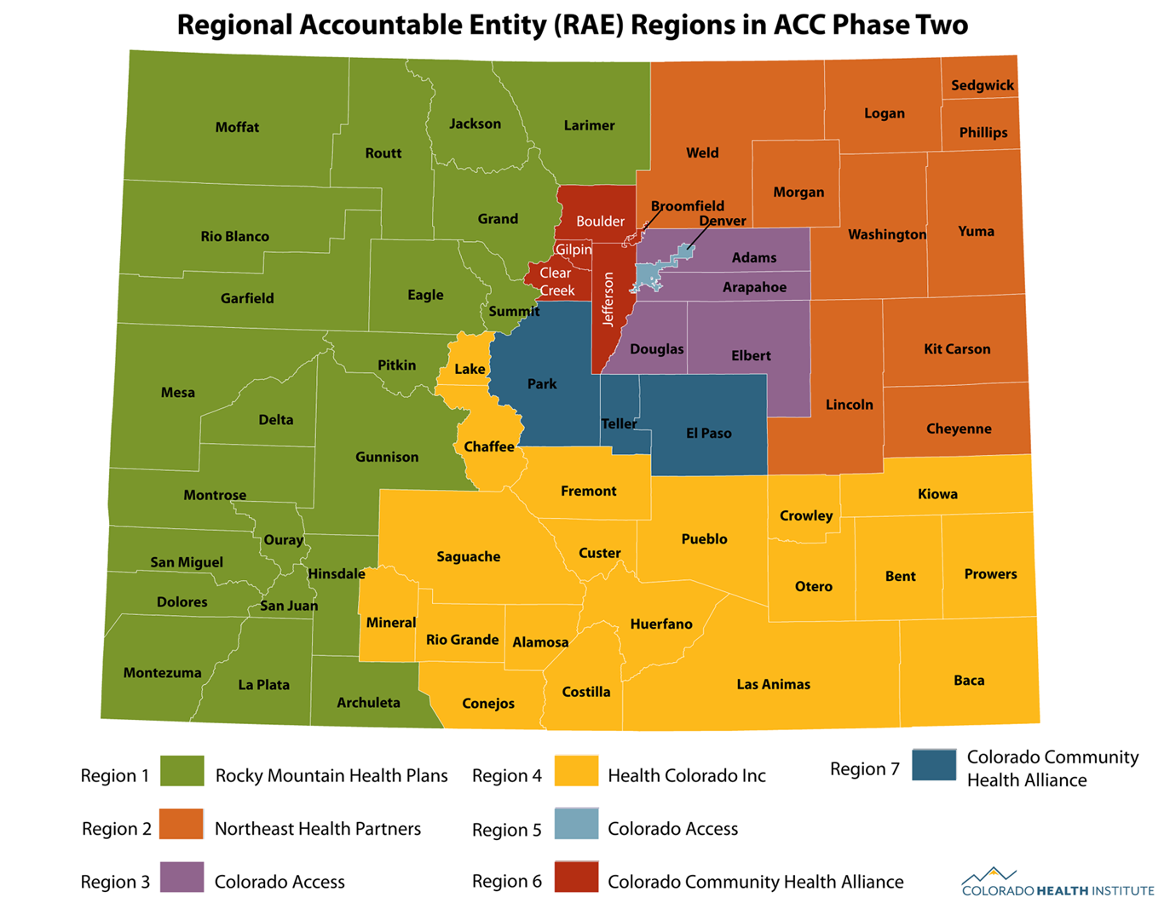
Who is Northeast Health Partners?
Northeast Health Partners (NHP) is a non-profit regional organization established in 2017
We are the current RAE for Region 2 and have served in that role since 2018
100% of our staff is Colorado-based
We are expanding our team for Phase III!

Slide 7
Mission and Vision
Mission
It is our mission to serve the members in our communities and provide a comprehensive range of physical and behavioral health services with commitment to compassionate service to meet the needs of our members.
Vision
To become the state’s preeminent Medicaid health plan by connecting local communities and resources together to meet member and provider needs.

Slide 8
Values
Unwavering Leadership: We strive to take the lead in advocating for our members, our providers, and our community groups to streamline process and eliminate unnecessary burdens to ensure seamless access to services.
Customer Service: We are committed to maintaining high-satisfaction for the service we provide across members, providers, and community-based organizations.
Achievement: We believe in continuous improvement and constant refinement to achieve results and offer high-quality care to Coloradans.
Responsiveness: We strive to be nimble and efficient in our operations and services.
Commitment: As a local organization focused on healthcare, we are committed to the community to ensure high-value services are available and accessible.
Transparency: We believe in clarity and openness to our activities for both our providers network and the public.

Slide 9
ACC Phase III
Updates & Key Changes

Slide 10
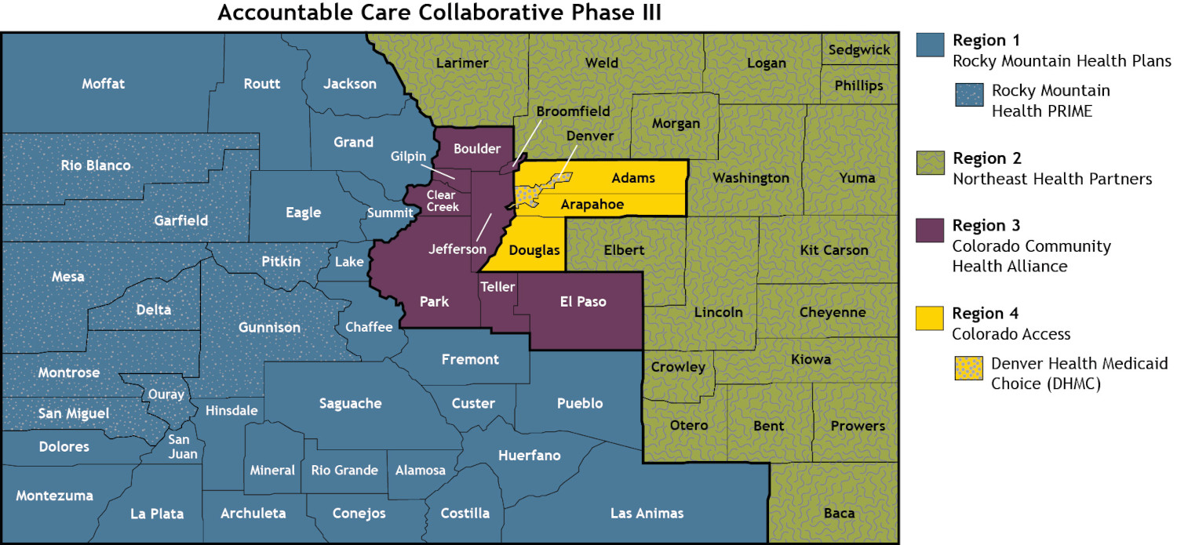
ACC Phase III Regional Entities and Counties

Slide 11
Key Changes for Phase III
New Logo
Expanded Office Locations
Greeley, Colorado: Corporate Office
Akron, Colorado: Regional Hub
Lamar, Colorado: Regional Hub
New Behavioral Health Partnership with Rocky Mountain Health Plans
Seamless Behavioral Health Network
Single contract for BH Providers
Physical Health Contracts will be managed by NHP staff
NHP is always a point of contact!

Slide 12
Timeline
Phase III Contract with HCPF
- Still in Development
- Pending Joint Budget Committee Finalization
Physical Health Contracting
- In Development
- Pending Budget Finalization
-Practice Assessment Tool Feedback
Behavioral Health Contracting
- Starting Now!
- Letters to Current Providers and New Providers
- NHPrae_bh_pr@uhc.com
Phase III Go Live
- July 1st, 2025
Notes:
Update the Timeline for 2/26

Slide 13
Program-Specific Changes
Updates & Key Changes

Slide 14
Physical Health Attribution & Performance Measures
Phase II Attribution
Based on geography
Uses a family-centric model
Assigns members to clinics
PCMPs are responsible for all assigned members
Performance incentives are RAE-specific and depend on regional performance
Phase III Attribution
No geographical attribution
Does not assess family utilization
Assigns members to clinics based on claims
If the member has no claims, they will not be assigned a PCMP. The RAE will be responsible for assigning a PCMP.
Performance measures are clinic-specific and are not dependent on regional performance

Slide 15
Physical Health Contracting
PMPM amounts are still being determined by the state
NHP has a draft PMPM framework for providers. We are awaiting a final budget
PCMP Payments will be made based on the PCMP’s tier
PCMP contracts are in development and communications will be sent soon
Contact Alma Mejorado, Provider Network Consultant, at alma@nhpllc.org
Notes:
ADD PROVIDER LETTER FROM ALMA

Slide 16
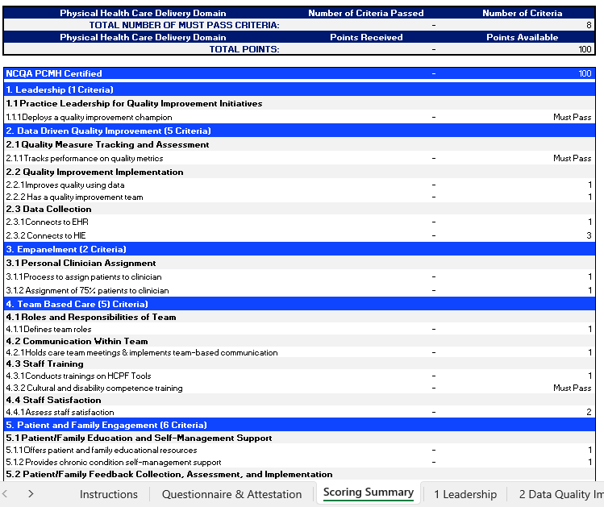
Physical Health PCMP Tiers
Phase III will include 3 different PCMP tiers based on capabilities and engagement
Tiers will be based on a score from a practice assessment
To obtain the Practice Assessment, please reach out to Alma Mejorado at Alma@nhpllc.org:
Your feedback is requested!

Slide 17
PCMP Key Dates for Contracting and Attribution
NHP Conducts Provider Meet and Greets | January 26, 2025 February 26, 2025 March, April, May, and June
NHP initiates individual PCMP Outreach | February 10, 2025
PCMP Practice Sites Complete Practice Assessment Note: must be completed prior to progressing to contracting | March 4, 2025
Execute Provider Agreements | March 5 - April 20, 2025
PCMP submits completed supporting documents (i.e. W9, BAA, practice demographics) | March 5 - April 20, 2025
NHP Submit Final List of Contracted PCMP to HCPF | April 30, 2025
HCPF begins member attribution process | May 1, 2025
HCPF begins member noticing | May 15, 2025
ACC Phase III Program Launch Date | July 1, 2025

Slide 18
Next Steps
Timelines & Upcoming Events

Slide 19
Opportunities to Connect with NHP
Providers:
April QI/Pop Health Committee
April Regional and State PIAC
Behavioral Health Office Hours
Provider Council – New for Phase III
Members:
Member Advisory Committee
Member Materials Review Subcommittee
Regional and State PIAC
Web-Based Meet-and-Greets
March 19 at 2:00
April 23 at 2:00
May 28 at 3:00
June 18 at 2:00
PCMP Contracting Webinar
Tentative: Week of March 10th.
Practice Assessments:
At your convenience
In-Person Meetings:
TBD: We will come to you!

Slide 20
Things to do Before July 1st
BH Providers:
Start contracting with RMHP if you aren’t already
Submit current claims timely
Reach out to your Practice Transformation Coach with any questions
Physical Health Providers:
Look for future communications on contracting
Review the Practice Assessment Tool and provide input to share with HCPF
Reach out to your Practice Transformation Coach with any questions
All Providers and Members:
Come to any of our regional meetings to learn more about Phase III programs activities
Let us know if you want to meet in person!

Slide 21
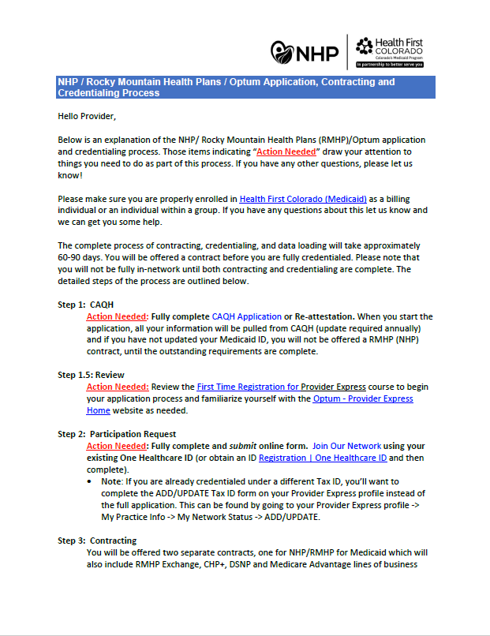
Behavioral Health Contracting
Can Be Found on https://www.northeasthealthpartners.org/ under “Providers” → “Join Our Network”
Email NHPrae_bh_pr@uhc.com with any questions
Christopher Miller, RMHP Director or Provider Relations, at Christopher_Miller@uhc.com
Notes:
Do we have a final RHMP Letter to include?

Slide 22
Contact NHP
Kari Snelson, CEO: kari@nhpllc.org
Dr. Brian Robertson, COO: brian@nhpllc.org
Jen Hale-Coulson, CoCO: jennifer@nhpllc.org
Raina Ali, Community Relations Manager: raina@nhpllc.org
970-909-4318
Phase III Questions: nhpphase3@nhpllc.org
Behavioral Health Contracting:
NHPrae_bh_pr@uhc.com
Christopher Miller, Dir. of Provider Relations Christopher_Miller@uhc.com
Physical Health Contracting:
Alma Mejorado, Provider Network Consultant, alma@nhpllc.org

Slide 23
Questions?

Slide 24
Thank you!
Northeast Health Partners
Nhpphase3@nhpllc.org
Northeasthealthpartners.org

